Slide 1



2024
Reasoning on Graphs:
Faithful and Interpretable Large Language Models Reasoning
Linhao Luo, Yuan-Fang Li, Gholamreza Haffari, Shirui Pan
Monash University and Griffith University

Slide 2
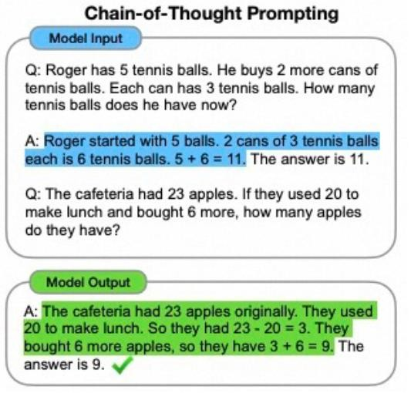


Background
Large language models (LLMs) exhibit a great reasoning ability.
Chain-of-Thoughts
Math Problem
Science Discovery Question Answering
….
LLMs
Reasoning
Tasks
Monash University

Slide 3
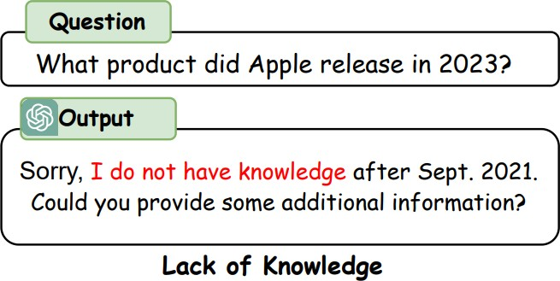
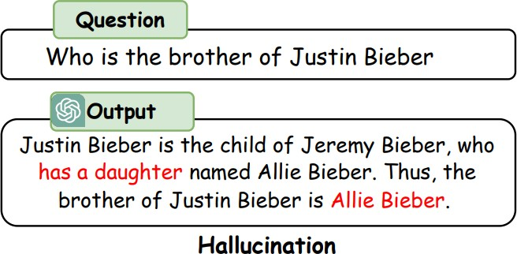
Limitations
LLMs lack up-to-date knowledge and experience hallucinations during reasoning.
Monash University

Slide 4
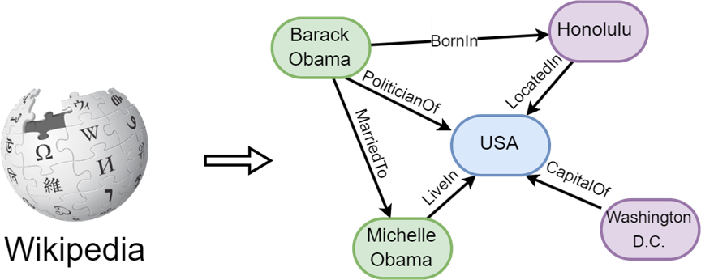
Motivations
Knowledge graphs (KGs) contain abundant factual knowledge in a structured format.

Slide 5
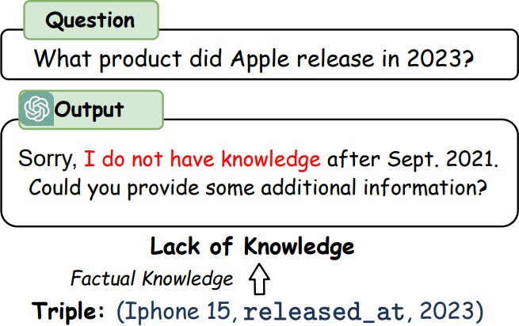
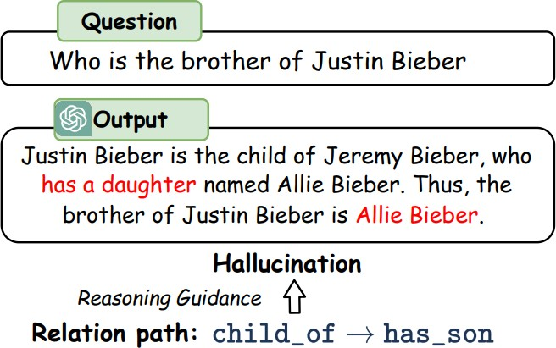
Motivations
Knowledge graphs (KGs) offer a reliable source of knowledge for reasoning.

Slide 6
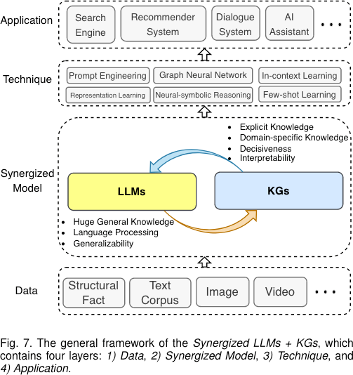
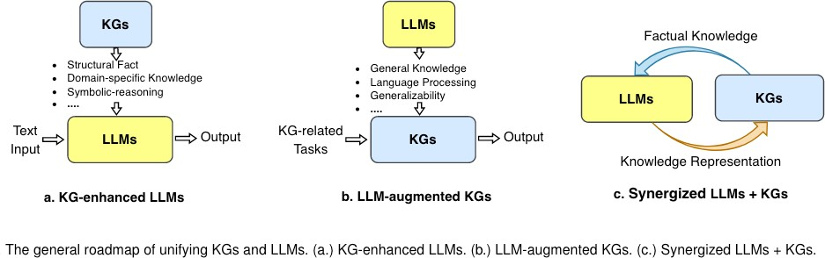
KGs + LLMs
Unifying Large Language Models and Knowledge Graphs: A Roadmap
TKDE
Pan, S., Luo, L., et al. (2024). Unifying large language models and knowledge graphs: A roadmap. TKDE.

Slide 7
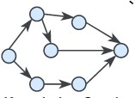
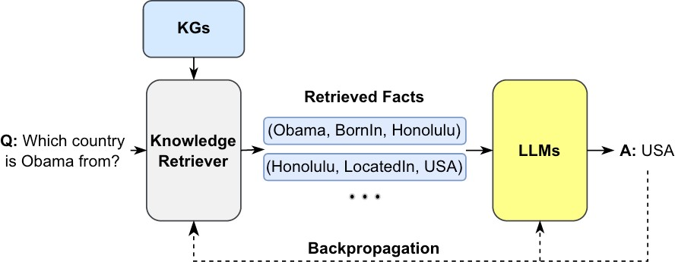
KG-enhanced LLM Reasoning
Retrieval-Augmented LLM Reasoning (RAG)
RQ1: How to effectively retrieve from KGs?
RQ2: How to reason on retrieved KG?
How to effectively utilize the KGs for LLMs reasoning?
Pan, S., Luo, L., et al. (2024). Unifying large language models and knowledge graphs: A roadmap. TKDE.

Slide 8
Cha llenges: How to reason on graphs?
Plan-and-solve reasoning
The plan is a hidden logic that can guide the reasoning.
LLMs
1. Planning
Step 1. Find the person that “Alice” is married to. Step 2. Find the child of that person.
Q: Who is the child of Alice?
2. Reasoning
Step 1. “Alice” is married to “Bob”
Step 2. “Bob” is the father of “Charlie” Thus, the answer is “Charlie”.
Wang, L., et al. (2023). Plan-and-solve prompting: Improving zero-shot chain-of-thought reasoning by large language models. ACL 2023.
Monash University
8

Slide 9
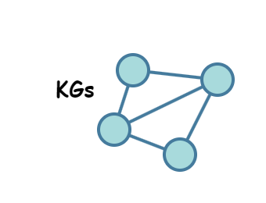
Cha llenges: How to reason on graphs?
Relation paths as plans
Relation paths are a sequence of relations that can serve as faithful plans for reasoning on graphs.
Example:
Question:
Who is the child of Alice?
Relation path 𝒛:
Plan:
Step 1. Find the person that “Alice” is married to. Step 2. Find the child of that person.
Execute the plan on KGs to retrieve reasoning paths.
Reasoning paths 𝒘_{𝒛}:
Answer

Slide 10
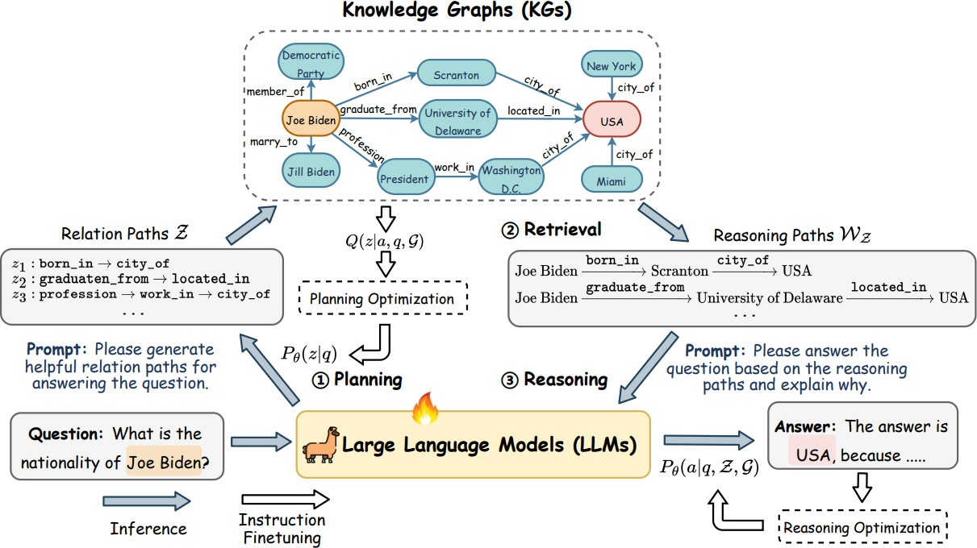
Reasoning on graphs (RoG)
Planning-retrieval-reasoning
Planning: generate faithful relation paths as plans.
Retrieval-Reasoning: reason the
answer on graphs with the plans.
Monash University

Slide 11

Reasoning on graphs (RoG): Planning-retrieval-reasoning
Reasoning
Planning
How to make sure the plan is faithful?
This function cannot be directly optimized as we do not know the golden plan.
Monash University

Slide 12
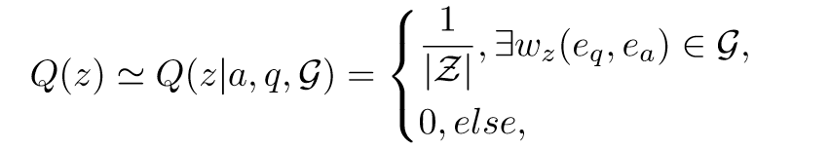

Reasoning on graphs (RoG)
Reasoning Planning
ELBO loss
Estimate the posterior distribution of faithful relation paths with the shortest path
connecting question and answer entities on KGs.
Two instruction tunning tasks
Monash University

Slide 13
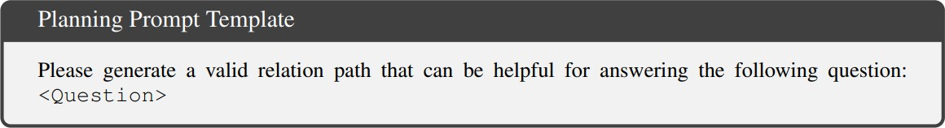
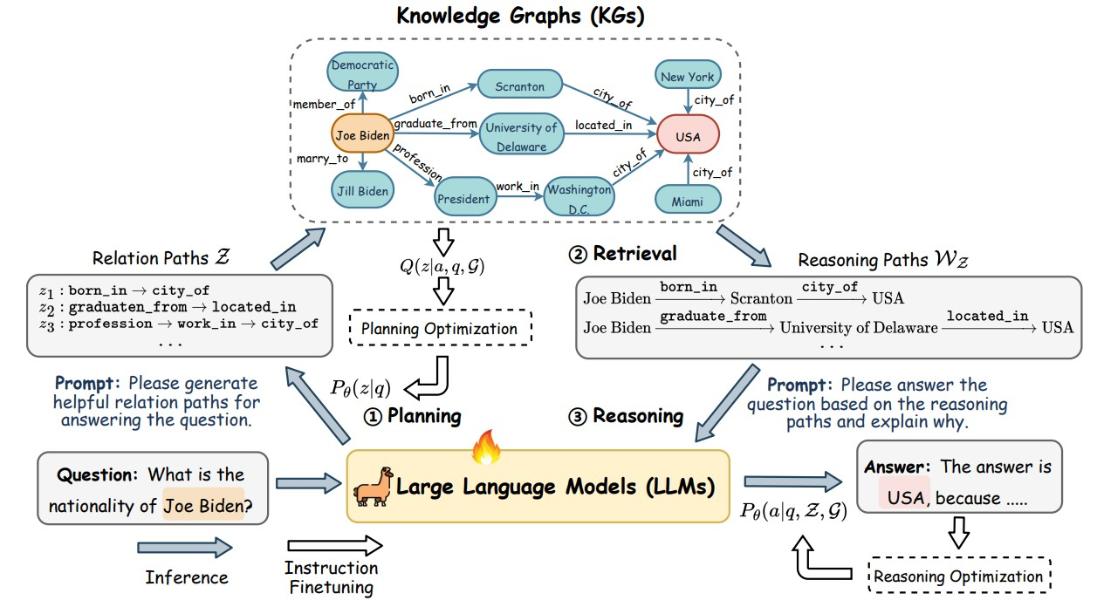
Planning-retrieval-reasoning
Planning: generate faithful relation paths as plans.
Monash University

Slide 14
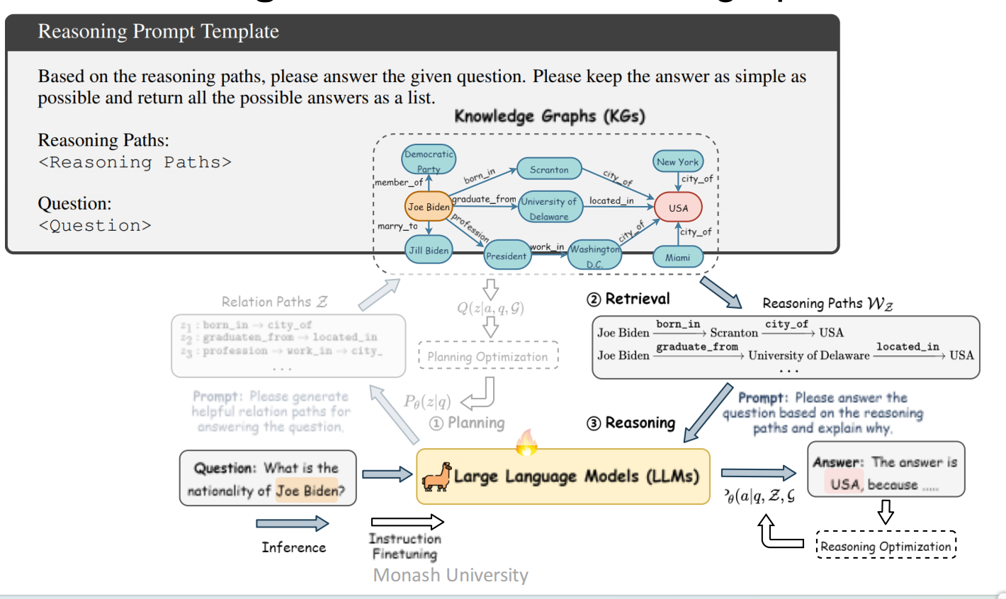
Planning-retrieval-reasoning
Retrieval-Reasoning: reason the answer on graphs with the plans.
Monash University

Slide 15
Experiments
RQ1: Can RoG perform effective reasoning?
RQ2: Can the planning module of RoG be integrated with other LLMs to improve their performance?
RQ3: Can RoG generate faithful and interpretable results?
Monash University

Slide 16
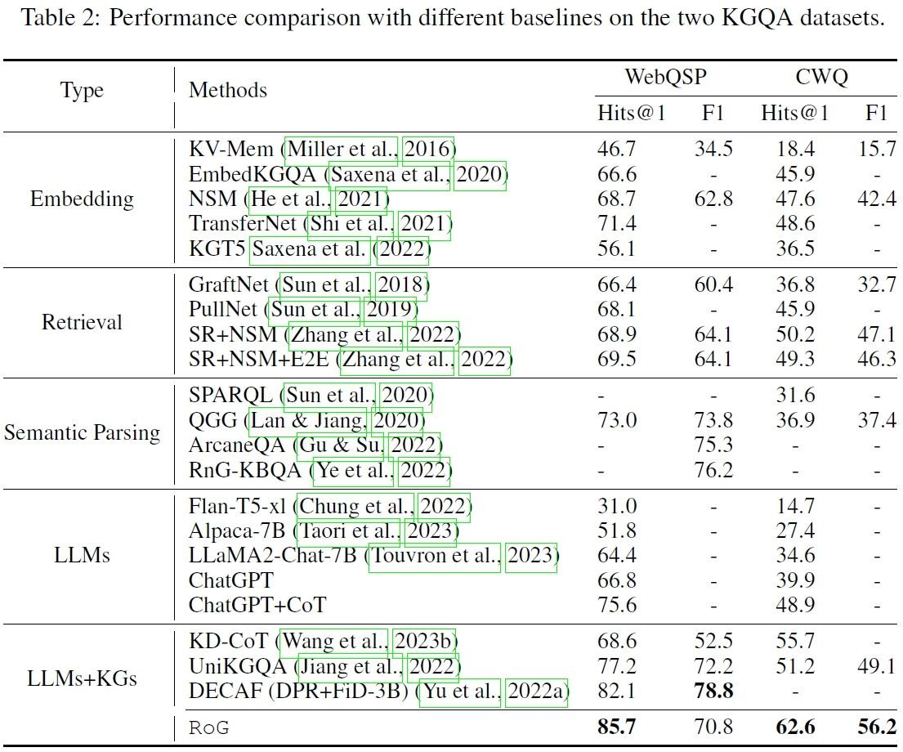
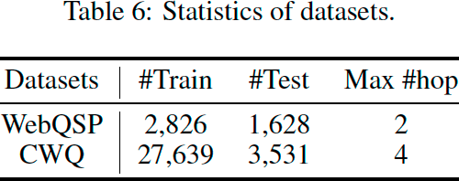
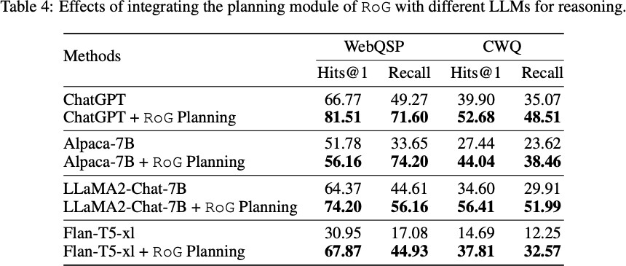
Experiments
We feed the RoG retrieved reasoning paths into other LLMs without training them.
Performance on KGQA tasks.
(RQ1: Effective reasoning)
Plug-and-play with other LLMs ₁₇
(RQ2: Effective retrieval)
Monash University

Slide 17
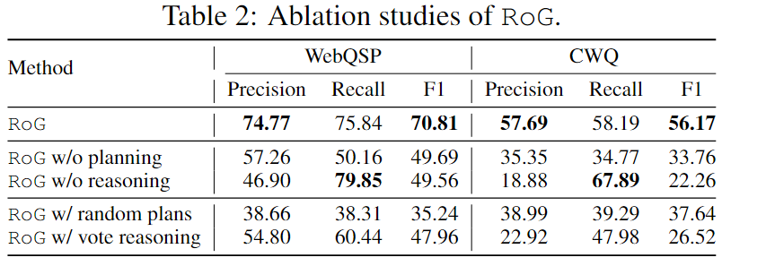
Experiments
Ablation Study.
Monash University

Slide 18
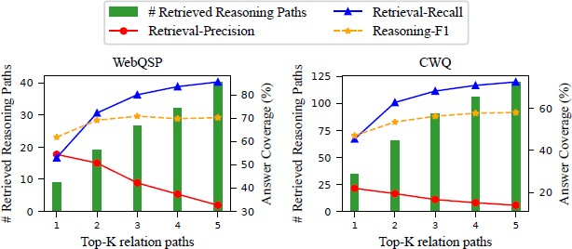
Faithfulness of generated relation Paths
More relation paths increase answer coverage but also introduce noise, not necessarily improving reasoning performance.
A large context of LLMs cannot address all problems without a sanitary context information.
Monash University

Slide 19
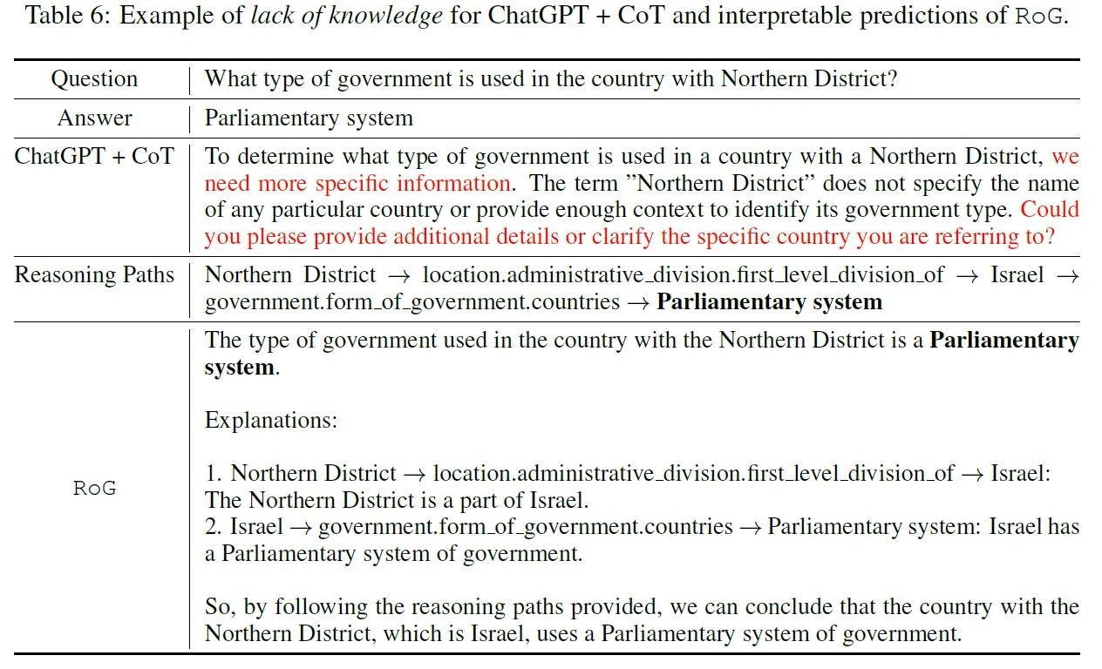
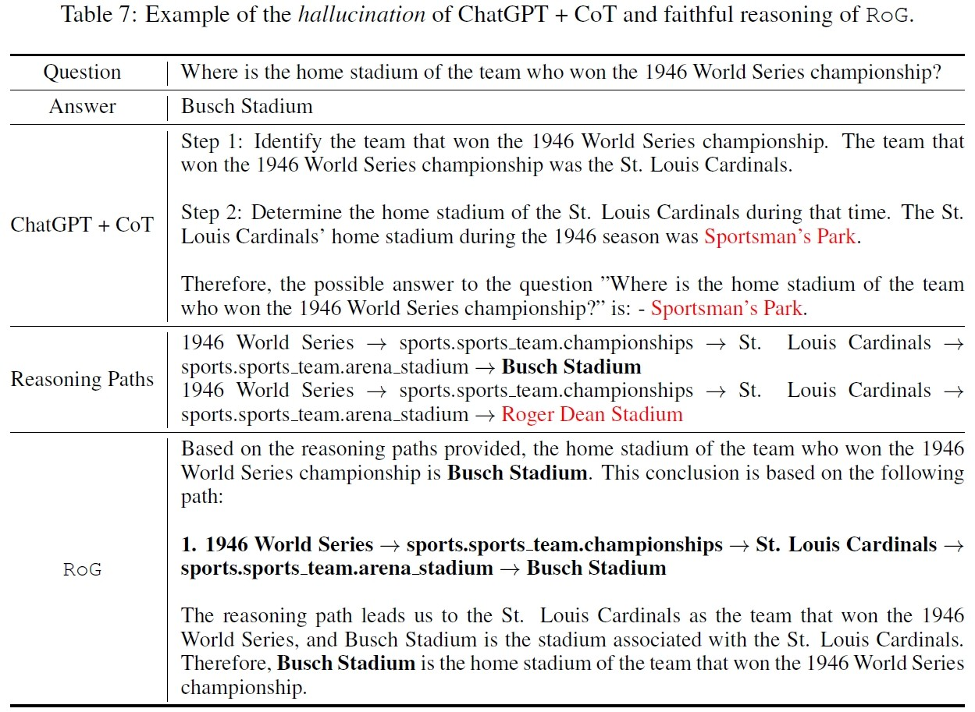
Faithful reasoning and interpretable results
RQ4: faithful and interpretable results
Lack of knowledge
Hallucination
Monash University

